Slide 1
Introduction to Apache Spark
Vinay Shashank
Dec 2nd 2015

Slide 2
Agenda
Overview & History
Applications
Spark Stack
MapReduce
Motivation for Spark
RDDs
Transformations & Actions
Use Case

Slide 3
What is Apache Spark?
Apache Spark is a fast and general purpose computational engine for large-scale data processing
Written in Scala
Functional Programming language
Key Concepts
Avoid data bottlenecks by distributing the data when it is stored
Bring the processing to the data
Data stored in memory
10-100x faster than MapReduce on disk/memory
Powerful Scala, Python, Java and R APIs

Slide 4
Brief History
Originally developed in 2009 in AMP Lab in UC Berkeley
Open sourced in 2010
Became a Top-Level Apache project in 2014
Has in excess of 750 active contributors as of 2015
Most active open source project in big data
Won the Daytona Graysort contest in 2014
Sorted 100TB of data in 23 mins making it the fastest open source computational engine
Databricks – company founded by the creators of Apache Spark

Slide 5
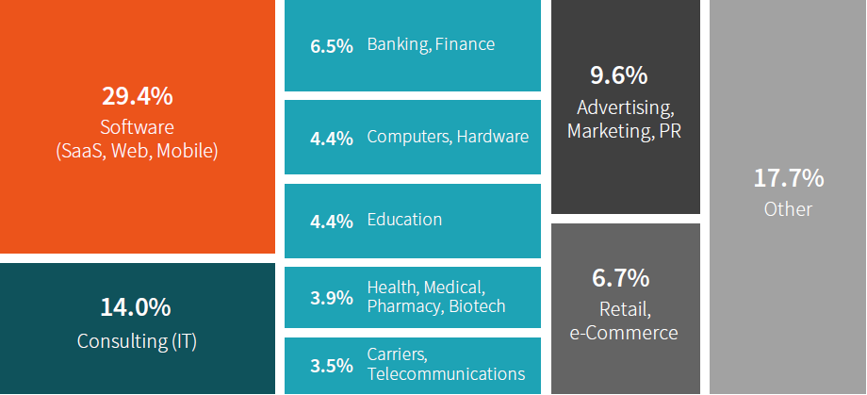
Industries Using Spark
http://www.slideshare.net/databricks/spark-summit-eu-2015-matei-zaharia-keynote

Slide 6
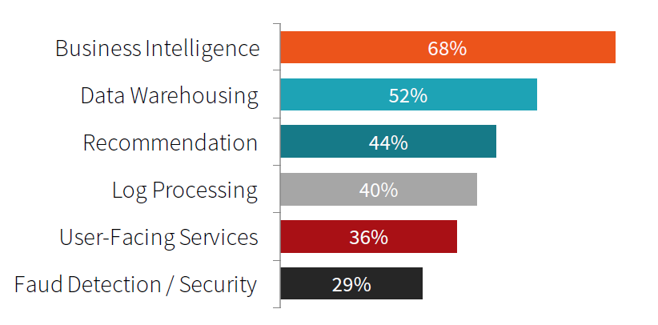
Top Applications
http://www.slideshare.net/databricks/spark-summit-eu-2015-matei-zaharia-keynote

Slide 7
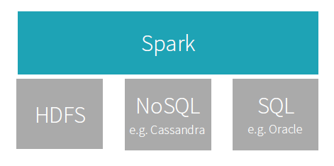
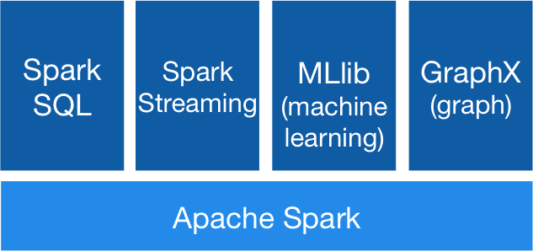
Spark Stack
General purpose engine
Independent of the storage layer
http://spark.apache.org/

Slide 8
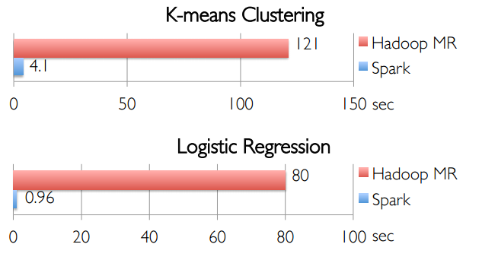
Spark is fast!
https://courses.edx.org/c4x/BerkeleyX/CS100.1x/asset/Week2Lec3.pdf

Slide 9
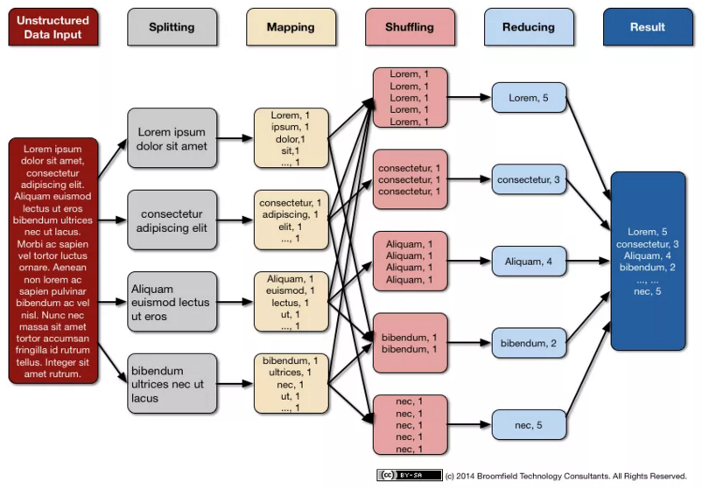
Map Reduce

Slide 10
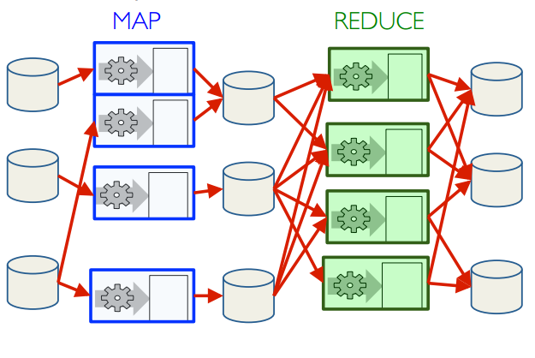
A lot of Disk I/O is involved in MapReduce
https://courses.edx.org/c4x/BerkeleyX/CS100.1x/asset/Week2Lec3.pdf

Slide 11
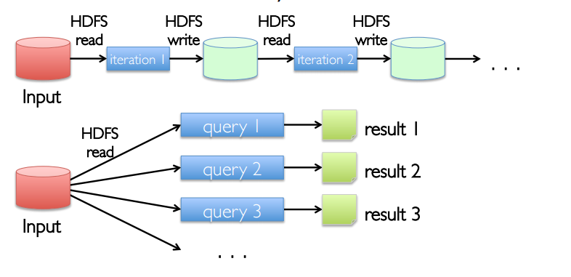
Apache Spark Motivation
https://courses.edx.org/c4x/BerkeleyX/CS100.1x/asset/Week2Lec3.pdf

Slide 12
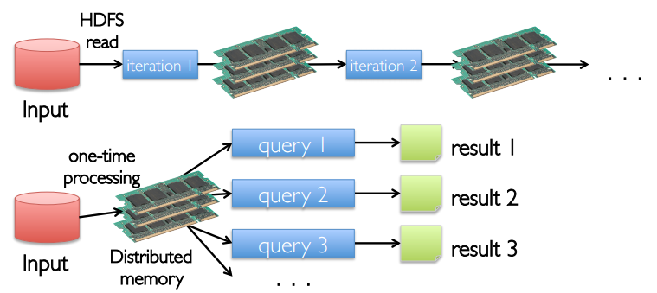
Apache Spark Motivation
https://courses.edx.org/c4x/BerkeleyX/CS100.1x/asset/Week2Lec3.pdf

Slide 13
Apache Spark Motivation
Leverage the drop in the cost of memory
Install more memory on the machines
Keep more data in-memory
Memory storage offers two significant advantages over disk
Faster read/write time
Avoids serialization and deserialization

Slide 14
Resilient Distributed Datasets
RDD is an immutable and partitioned collection of records
The primary form of abstraction in Spark
Resilient : If data is lost, it can be recreated
Distributed : Data is stored in memory across the cluster
Track lineage information to recompute lost data
RDDs are computed lazily

Slide 15



Methods of creating RDDs
RDDs are created
by parallelizing existing collection
by transforming an existing RDD
from files in HDFS or any other storage system

Slide 16
Types of operations on RDDs
Two types of operations can be performed on RDDs
Transformations – Create new RDDs
Actions – Return a value
Transformations are lazily evaluated
Transformed RDD is executed when an action runs on it
RDDs can be persisted in memory

Slide 17
Transformations
Transformation | Description
map( func ) | Return a new distributed dataset formed by passing each element of the source through a function func
filter( func ) | Return a new dataset formed by selecting those elements of the source on which func returns true
distinct([ Num of Tasks]) | Return a new dataset that contains the distinct elements of the source dataset
flatMap( func ) | Similar to map, but each input item can be mapped to 0 or more output items (so func should return a Seq rather than a single item)

Slide 18
Actions
Transformation | Description
reduce( func ) | Aggregate the elements of the dataset using a function func (which takes two arguments and returns one). The function should be commutative and associative so that it can be computed correctly in parallel
take( n ) | Return all the elements of the dataset as an array at the driver program. This is usually useful after a filter or other operation that returns a sufficiently small subset of the data
collect() | Return the number of elements in the dataset
count() | Return the number of elements in the dataset
takeOrdered( n , key= func ) | Return the first n elements of the RDD using either their natural order or a custom comparator

Slide 19
Key Value RDDs and Transformations
Spark supports key-value pairs
Each element of a Pair RDD is a pair tuple
Key Value Transformation | Description
reduceByKey( func, [numTasks] ) | When called on a dataset of (K, V) pairs, returns a dataset of (K, V) pairs where the values for each key are aggregated using the given reduce function func, which must be of type (V,V) => V
sortByKey() | Return a new dataset formed by selecting those elements of the source on which func returns true
groupByKey( [numTasks]) | When called on a dataset of (K, V) pairs, returns a dataset of (K, Iterable<V>) pairs

Slide 20
Spark Program Lifecycle
Create RDDs from external data or parallelize a collection in your driver program
Lazily transform them into new RDDs by applying transformations
cache() some RDDs for reuse
Perform actions to execute parallel computation and produce results

Slide 21
Time for practice!

Slide 22
How to learn Spark?
Two great MOOCs available on edX
Introduction to Big Data with Apache Spark
Scalable Machine Learning – Advanced course
Spark Developer Resources on Databricks
AMP Lab workshop videos and exercises
Spark tutorials on Hortonworks

Slide 23
How to install Spark?
Virtual Machine Images with Spark pre-installed can be downloaded from Cloudera or Hortonworks
These images are very big in size around 7-10 GB in size
Alternative to that is the image available in the MOOCs mentioned in the previous slide

Slide 24
Happy Learning!

